Slide 1
Java GUIs: Swing
Also: Events and Inner Classes in Action

Slide 2
Goals
To use inheritance to customize frames
To understand how user-interface components are added to a container
To understand the use of layout managers to arrange user-interface components in a container
To become familiar with common user-interface components, such as buttons, combo boxes, text areas, and menus
To build programs that handle events from user-interface components
To learn how to browse the Java documentation

Slide 3
Using Inheritance to Customize Frames
Use inheritance for complex frames to make programs easier to understand
Design a subclass of JFrame
Store the components as instance fields
Initialize them in the constructor of your subclass
If initialization code gets complex, simply add some helper methods

Slide 4
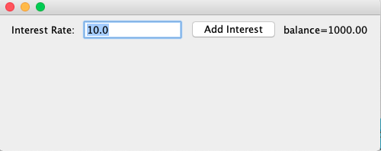
Example: Investment Viewer Program

Slide 5
Check
Why does the InvestmentFrame constructor call setSize(FRAME_WIDTH, FRAME_HEIGHT)?

Slide 6
Layout Management
Up to now, we have had limited control over layout of components
When we used a panel, it arranged the components from the left to the right
User-interface components are arranged by placing them inside containers
Each container has a layout manager that directs the arrangement of its components
Three useful layout managers:
border layout
flow layout
grid layout

Slide 7
Layout Management
By default, JPanel places components from left to right and starts a new row when needed
Panel layout carried out by FlowLayout layout manager
Can set other layout managers panel.setLayout(new BorderLayout());

Slide 8
Border Layout
Border layout groups container into five areas: center, north, west, south and east
Default layout manager for a frame (technically, the frame's content pane)
When adding a component, specify the position like this:
panel.add(component, BorderLayout.NORTH);
Expands each component to fill the entire allotted area If that is not desirable, place each component inside a panel

Slide 9
Grid Layout
Arranges components in a grid with a fixed number of rows and columns
Resizes each component so that they all have same size
Expands each component to fill the entire allotted area
Add the components, row by row, left to right:
JPanel numberPanel = new JPanel();
numberPanel.setLayout(new GridLayout(4, 3));
numberPanel.add(button7);
numberPanel.add(button8);
numberPanel.add(button9);
numberPanel.add(button4);

Slide 10
Grid Bag Layout
Tabular arrangement of components
Columns can have different sizes
Components can span multiple columns
Quite complex to use
Not going to cover this
Fortunately, you can create acceptable-looking layouts by nesting panels
Give each panel an appropriate layout manager
Panels don't have visible borders
Use as many panels as needed to organize components

Slide 11
Questions
How do you add two buttons to the north area of a frame?
First add them to a panel, then add the panel to the north end of a frame.
How can you stack three buttons on top of each other?
Place them inside a panel with a GridLayout that has three rows and one column.

Slide 12
Choices
Radio buttons
Check boxes
Combo boxes

Slide 13
Radio Buttons
For a small set of mutually exclusive choices, use radio buttons or a combo box
In a radio button set, only one button can be selected at a time
When a button is selected, previously selected button in set is automatically turned off
In previous figure, font sizes are mutually exclusive:
JRadioButton smallButton = new JRadioButton("Small");
JRadioButton mediumButton = new JRadioButton("Medium");
JRadioButton largeButton = new JRadioButton("Large");
// Add radio buttons into a ButtonGroup so that
// only one button in group is on at any time
ButtonGroup group = new ButtonGroup();
group.add(smallButton);
group.add(mediumButton); group.add(largeButton);

Slide 14
Radio Buttons
Button group does not place buttons close to each other on container
It is your job to arrange buttons on screen
isSelected: called to find out if a button is currently selected or not
if (largeButton.isSelected()) size = LARGE_SIZE;
Call setSelected(true) on a radio button in group before making the enclosing frame visible

Slide 15
Borders
Place a border around a panel to group its contents visually
EtchedBorder: three-dimensional etched effect
Can add a border to any component, but most commonly to panels:
JPanel panel = new JPanel();
panel.setBorder(new EtchedBorder());
TitledBorder: a border with a titlepanel.
setBorder(new TitledBorder(new EtchedBorder(), "Size"));

Slide 16
Check Boxes
Two states: checked and unchecked
Use one checkbox for a binary choice
Use a group of check boxes when one selection does not exclude another
Example: "bold" and "italic" in previous figure
Construct by giving the name in the constructor:
JCheckBox italicCheckBox = new JCheckBox("Italic");
Don't place into a button group

Slide 17
Combo Boxes
For a large set of choices, use a combo box
Uses less space than radio buttons
"Combo": combination of a list and a text field
The text field displays the name of the current selection

Slide 18
Combo Boxes
If combo box is editable, user can type own selection
Use setEditable method
Add strings with addItem method:
JComboBox facenameCombo = new JComboBox(); facenameCombo.addItem("Serif");
facenameCombo.addItem("SansSerif"); . . .
Get user selection with getSelectedItem (return type is Object)
String selectedString = (String) facenameCombo.getSelectedItem();
Select an item with setSelectedItem

Slide 19
Radio Buttons, Check Boxes, and Combo Boxes
They generate an ActionEvent whenever the user selects an item
An example: ChoiceFrame
All components notify the same listener object
When user clicks on any component, we ask each component for its current content
Then redraw text sample with the new font

Slide 20
Classes of the Font Choice Program

Slide 21
Questions
What is the advantage of a JComboBox over a set of radio buttons? What is the disadvantage?
you have many options, a set of radio buttons takes up a large area. A combo box can show many options without using up much space. But the user cannot see the options as easily.
Why do all user interface components in the ChoiceFrame class share the same listener?
When any of the component settings is changed, the program simply queries all of them and updates the label.
Why was the combo box placed inside a panel? What would have happened if it had been added directly to the control panel?
To keep it from growing too large. It would have grown to the same width and height as the two panels below it.

Slide 22
Menu
A frame contains a menu bar
The menu bar contains menus
A menu contains submenus and menu items

Slide 23
Menu Items
Add menu items and submenus with the add method:
JMenuItem fileExitItem = new JMenuItem("Exit");
fileMenu.add(fileExitItem);
A menu item has no further submenus
Menu items generate action events
Add a listener to each menu item:
fileExitItem.addActionListener(listener);
Add action listeners only to menu items, not to menus or the menu bar

Slide 24
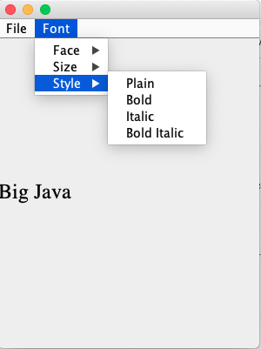
The Menu Frame program
Builds up a small but typical menu
Traps action events from menu items
To keep program readable, use a separate method for each menu or set of related menus
createFaceItem: creates menu item to change the font face
createSizeItem
createStyleItem

Slide 25
Text Areas
Use a JTextArea to show multiple lines of text
You can specify the number of rows and columns:
final int ROWS = 10; final int COLUMNS = 30;
JTextArea textArea = new JTextArea(ROWS, COLUMNS);
setText: to set the text of a text field or text area
append: to add text to the end of a text area
Use newline characters to separate lines:
textArea.append(account.getBalance() + "\n");
To use for display purposes only:
textArea.setEditable(false); // program can call setText and append to change it

Slide 26
To add scroll bars to a text area:
JTextArea textArea = new JTextArea(ROWS, COLUMNS);
JScrollPane scrollPane = new JScrollPane(textArea);

Slide 27
Questions
What is the difference between a text field and a text area?
A text field holds a single line of text; a text area holds multiple lines.
Why did the TextAreaViewer program call textArea.setEditable(false)?
The text area is intended to display the program output. It does not collect user input.
How would you modify the TextAreaViewer program if you didn't want to use scroll bars?
Don't construct a JScrollPane and add the textArea object directly to the frame.

Slide 28
Exploring Swing Documentation
All work in Java ultimately involves:
Reading the API documents
Googling for answerson Stackoverflow.com
Next example will show how to use the documentation to your advantage

Slide 29
Example: Color Mixer
It should be fun to mix your own colors, with a slider for the red, green, and blue values

Slide 30
Example: A Color Mixer
How do you know if there is a slider?
Buy a book that illustrates all Swing components
Run sample application included in the JDK that shows off all Swing components
Look at the names of all of the classes that start with J
JSlider seems like a good candidate
Next, ask a few questions:
How do I construct a JSlider?
How can I get notified when the user has moved it?
How can I tell to which value the user has set it?
After mastering sliders, you can find out how to set tick marks, etc.

Slide 31
The Swing Demo Set

Slide 32
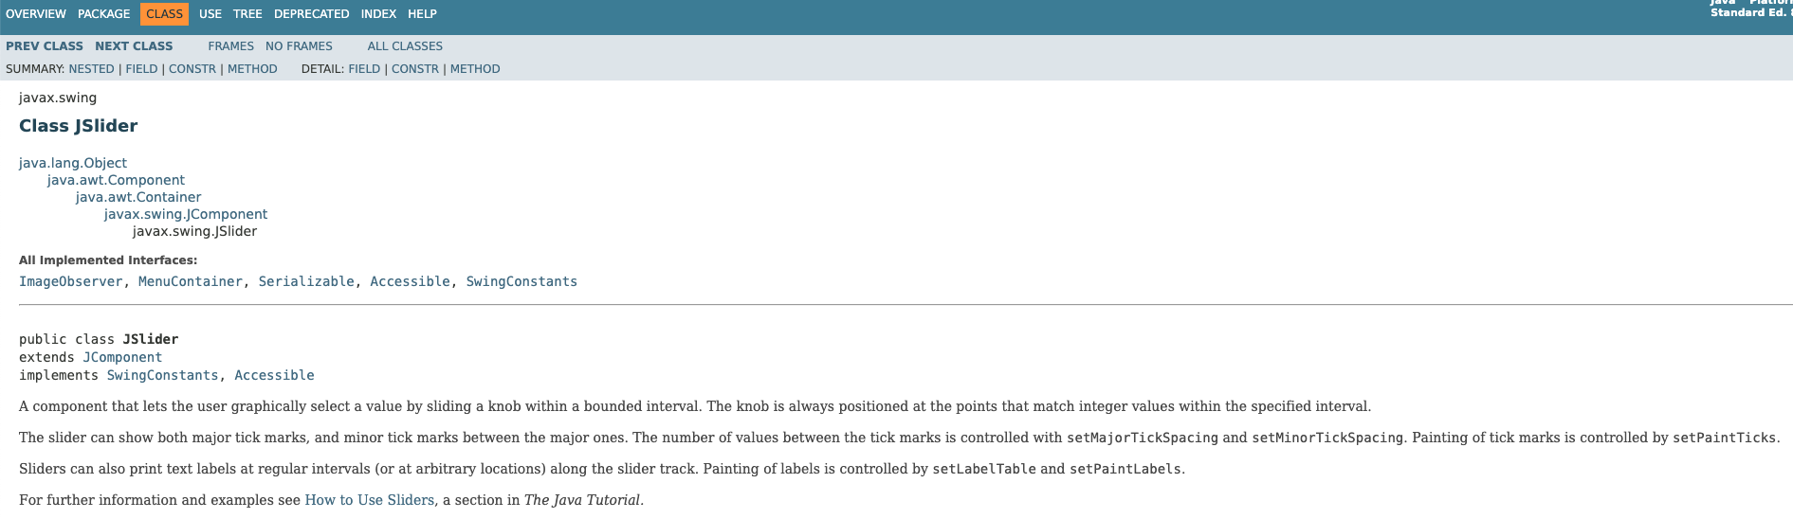
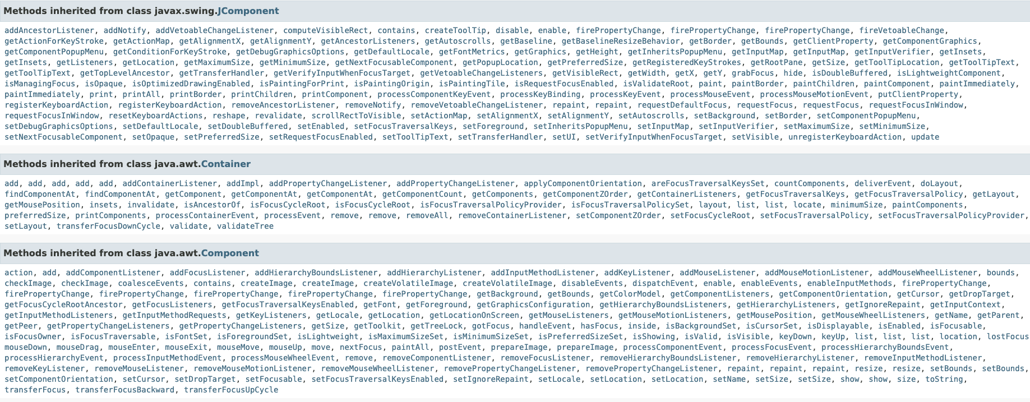
Example: A Color Mixer
There are over 50 methods in JSlider class and over 250 inherited methods
Some method descriptions look scary
Develop the ability to separate fundamental concepts from ephemeral minutiae

Slide 33
How do I construct a JSlider?
Look at the Java version 8.0 API documentation
There are six constructors for the JSlider class
Learn about one or two of them
Strike a balance somewhere between the trivial and the bizarre
Too limited: public JSlider() Creates a horizontal slider with the range 0 to 100 and an initial value of 50
Bizarre: public JSlider(BoundedRangeModel brm) Creates a horizontal slider using the specified BoundedRangeModel
Useful: public JSlider(int min, int max, int value) Creates a horizontal slider using the specified min, max, and value.

Slide 34
How can I get notified when the user has moved a JSlider?
There is no addActionListener method
There is a method public void addChangeListener(ChangeListener l)
Click on the ChangeListener link to learn more
It has a single method: void stateChanged(ChangeEvent e)
Apparently, method is called whenever user moves the slider
What is a ChangeEvent?
It inherits getSource method from superclass EventObject
getSource: tells us which component generated this event

Slide 35
How can I tell to which value the user has set a JSlider?
Now we have a plan:
Add a change event listener to each slider
When slider is changed, stateChanged method is called
Find out the new value of the slider
Recompute color value
Repaint color panel
Need to get the current value of the slider
Look at all the methods that start with get; you find: public int getValue() Returns the slider's value.

Slide 36
The Components of the SliderFrame

Slide 37
Classes of the SliderFrameViewer Program
JFrame
SliderFrame
JSlider

